Slide 1

FACE RECOGNITION
Hetvi Gudka

Slide 2



Problem Statement
Not always sure of what sort of music to listen to?
This app helps to recognize your mood, based on facial expressions. Accordingly, a playlist is chosen, and songs are played on a music player.

Slide 3
Timeline
Week 1
Went through all topics. Looked them up. Decided on face recognition.
Week 2
Chose a topic in face recognition. Learnt basic concepts on how to use OpenCV. Decided on Django framework for the web application.
Week 3
Made basic Django project and application. Tried calling a face API. Firebase data connection and storage. Got complicated, so decided to go another way.
Week 4
Used DeepFace python library. Added data in sqlite database supported by Django. Recognizes face emotion and songs based on it are played on a music player.

Slide 4
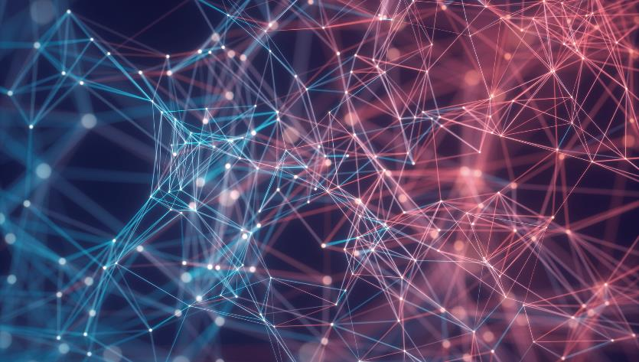

Thank You

